Slide 1
Syllable and Word Stress

Slide 2
Syllable
A syllable is a basic unit of spoken language, that comprises uninterrupted sounds. For example, the word hotel has two syllables: ho + tel.

Slide 3
Counting Syllables
To find the number of syllables in a word, use the following steps:
Count the vowels in the word
Subtract any silent vowels, (like the silent e at the end of a word, or the second vowel when two vowels are together in a syllable)
Subtract one vowel from every diphthong (diphthongs only count as one vowel sound.)
The number of vowels sounds left is the same as the number of syllables

Slide 4
Cont…
The number of syllables that you hear when you pronounce a word is the same as the number of vowel sounds heard. For example:
The word came has 2 vowels, but the e is silent, leaving one vowel sound and one syllable
The word outside has 4 vowels, but the e is silent and the ou is a diphthong which counts as only one sound, so this word has only two vowel sounds and therefore, two syllables

Slide 5
Example
Word |  | Number of Syllables
Dog | Dog | 1
Green | Green | 1
Quite | Quite | 1
Quiet | Qui-et | 2
Orange | O-range | 2
Table | Ta-ble | 2
Computer | Com-pu-ter | 3
Cancellation | Can-ce-la-tion | 4
Syllabification | Sy-lla-bi-fi-ca-tion | 6

Slide 6
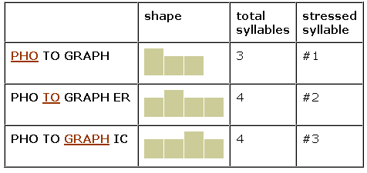
What is Word Stress?
In English, we do not say each syllable with the same force or strength. In one word, we accentuate ONE syllable. We say one syllable very loudly (big, strong, important) and all the other syllables very pronounced quietly.
photograph, photographer, photographic

Slide 7
Other Examples
TEACHer, JaPAN,
aBOVE, converSAtion, INteresting, imPORtant,
deMAND, etCETera,
CHINa
The syllables that are not stressed are weak
The syllables that are stressed are strong

Slide 8
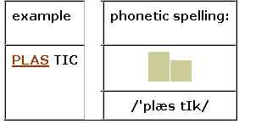
Where do I Put Word Stress?
The dictionaries giving the phonetic spelling of a word show which syllable is stressed, usually with an apostrophe (') just before the stressed syllable. Look at the example for the word plastic. There are 2 syllables. Syllable #1 is stressed.

Slide 9
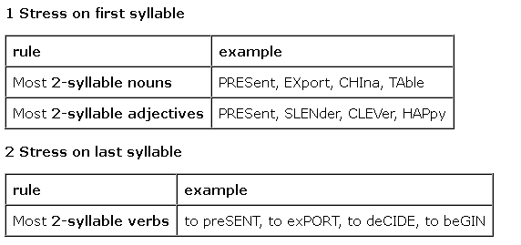
Rules of Word Stress in English
One word has only one primary stress
We can only stress vowels, not consonants

Slide 10
Cont..
There are many two-syllable words in English whose meaning and class change with a change in stress:
Word | Noun/Adjective | Verb
absent | ˈæb.sᵊnt | æb|ˈsent
conduct | ˈkɒn.dʌkt | kənˈdʌkt
present | ˈprez.ᵊnt | prɪ|ˈzent, prə-
content | ˈkɒn.tent | kənˈtent
desert | ˈdez.ət | dɪ|ˈzɜːt
perfect | ˈpɜː.fɪk|t | pəˈfekt, pɜː-
conflict | ˈkɒn.flɪkt | kənˈflɪkt

Slide 11
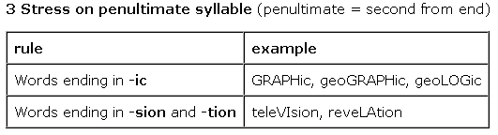
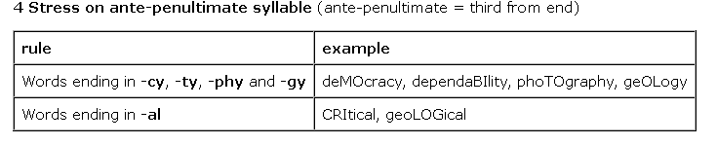
Cont…

Slide 12
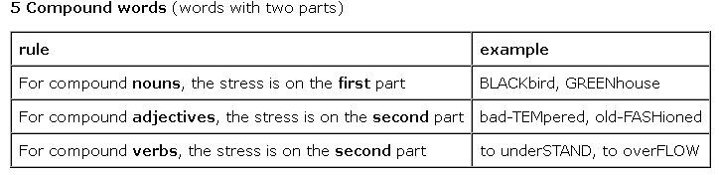
Cont..

